Slide 1
Face detection and Recognition
Presented By-
Sakshi
Suman Singh
Guided By-
Anchal Singh

Slide 2
Contents
Introduction to python
Features of python
Applications of python
Introduction to project
Modules used
conclusion

Slide 3
Introduction to python
Python is a popular programming language.It was created by guido van Rossum, and released in 1991.
It is used for :
web development (server-side),
Software development,
Mathematics
System scripting

Slide 4

Features of Python

Slide 5
Applications of python
Web development
Artificial Intelligence and Machine learning
Software Development
Image Processing and Graphic Design Applications
Game Development

Slide 6
Introduction to project
Face detection and recoginition by humans
Human brain is trained for face detection and recognition.Face detection and recognition is an easy task for humans.
Experimentally it has been found that even one to three day old babies are able to distinguish between known faces.

Slide 7


Face detection
Identify human faces with digital images.
Identifies the pixels which represents the face in a given image.
Also reffered to as the pre-processing phase.

Slide 8
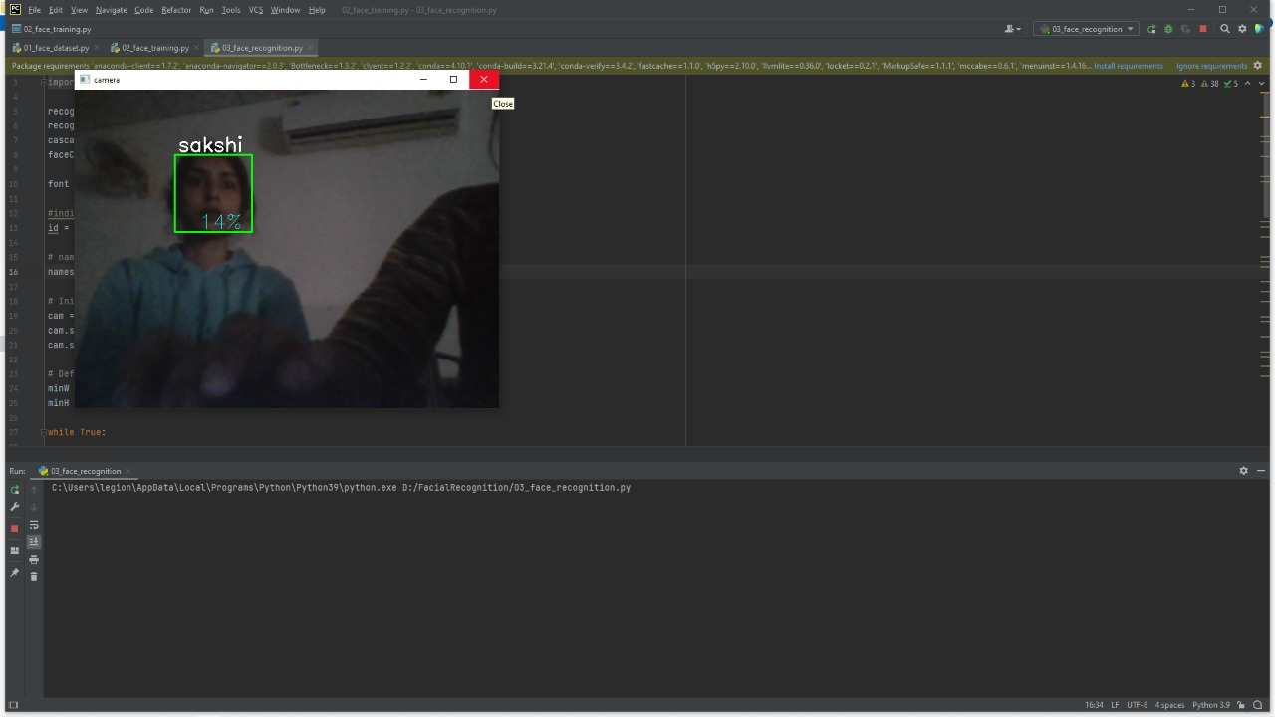
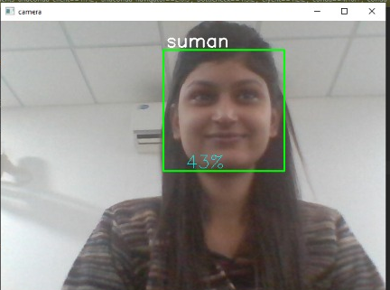
Face Recognition
Face Recoginition is the task of identifying an already detected face as a KNOWN or UNKNOWN face, and in more advanced cases, TELLING EXACTLY WHO’S IT IS!
Face recoginition problem statement:
Given still or video images of a scene ,identify or verity one or more persons in the scene using stored database of faces.

Slide 9
How it Works?
Features:
Distance between the eyes
Width of the nose.
Depth of the eye socket
Cheekbones
Jaw line
Chin
Face
detection
Features
extraction
Face
Recognition

Slide 10
Modules Used
Opencv - Opencv is a open source computer vision. It used to process images and videos in real time.
Numpy - Numpy which stands for Numerical Python, is a library for the python programming language, adding support for large , multi-dimensional arrays and matrices,along with a large collection of high-level mathematical functions to operate on these arrays.
Haar Cascade algo - It is an object detection Algorithm used to identify faces in an image or a real time video. These includes models for face detection, eye detection, upper body and lower body detection, license plate detection etc.

Slide 11
Face detection using Haar Cascades
Developed by Paul Viola and Michael Jones in 2001.
Robust and very quick.
15 times quicker than any technique at the time of release.
Could be operated in real-time.
(95% accuracy at around 17 fps.)
Feature extraction and feature valuation.
(rectangular features are used )
With a new image representation their calculation is very fast.
A degenerate decision tree of classifier is formed.

Slide 12
Features
Four basic types:
They are easy to calculate.
The white areas are subtracted from the black ones.
edge feature
line feature

Slide 13
Conclusion
The face recognition model has implemented including training and testing phases. The haar cascade classifier provided an approach to detect region of interest (ROI) and opencv helped to train the model using classifier.The model acquired accuracy of about 60-70 % as dataset used to training is not that large, but model can be improved with enhanced image dataset.

Slide 14
Thank you

